Slide 1
CLIMATE CHANGE
Joseph Karl Drosendahl
Geology Program
Phoenix College

Slide 2
DEFINITIONS
Weather: a daily condition of atmospheric events (i.e.: rain showers, wind direction, fog, snow amounts, etc.)
Climate: long term (years) condition of atmospheric events.
Global warming: the change in the yearly average of the world’s temperature.
Climate change: the long term (years) changes in atmospheric conditions, of which global warming is a part.

Slide 3
PAST CLIMATE CHANGE
The Earth’s climate has changed numerous times in the geologic past, and 5 times it caused mass extinctions. Climate change in the past has been influenced by several different events:
Changes in the sun’s output
Changes in the earth’s orbit
Meteors impacting the Earth
Natural changes in greenhouse gases levels

Slide 4
Currently there is another event that causes climate change: HUMAN ACTIVITY

Slide 5
CURRENT POTENTIAL CAUSES OF CLIMATE CHANGE
The Sun:
Changes in output
The Earth:
Changes in orbit (the Milankovitch cycles) which include:
The shape of Earth’s orbit, known as eccentricity;
The angle Earth’s axis is tilted with respect to Earth’s orbital plane, known as obliquity; and
The direction Earth’s axis of rotation is pointed, known as precession.

Slide 9
CURRENT POTENTIAL CAUSES OF CLIMATE CHANGE
Meteor impacts:
Results in decreased global temperatures due to material being ejected into the atmosphere.
Greenhouse gases (increases global temperatures)
Carbon dioxide
Methane
Nitrous Oxide
Chlorofluorocarbons (human created)
Water vapor

Slide 11
CURRENT POTENTIAL CAUSES OF CLIMATE CHANGE
Natural Sources of Greenhouse gases
Volcanoes
Volcanic ash: short term decrease in global temperature
Greenhouse gases: increases global temperature
Plants (increases O₂ levels, decreases global temperatures)
Human Source of Greenhouse gases
Use of fossil fuels (i.e., coal, petroleum & natural gas) increases greenhouse gases which increases global temperatures

Slide 12
WHAT IS CAUSING THE CURRENT CLIMATE CHANGE?
Sun’s output: current output is static or decreasing

Slide 13
WHAT IS CAUSING THE CURRENT CLIMATE CHANGE?
Earth’s orbit:
results in long term climate changes, unlike current climate change.
Volcanoes:
no great increase in current eruptions
current volcanic eruptions produces 100 times less amount of CO₂ than humans

Slide 14
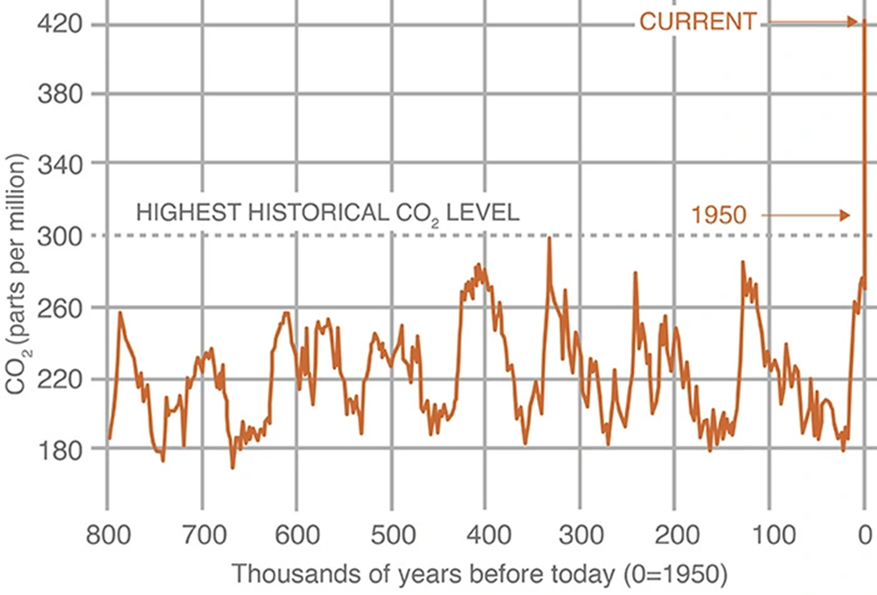
WHAT IS CAUSING THE CURRENT CLIMATE CHANGE?
CARBON DIOXIDE LEVELS
So, that leaves humans as the main cause of the current climate change, due to the use of fossil fuels.

Slide 15
CARBON DIOXIDE LEVELS AT MAUNA LOA, HAWAII

Slide 16
WORLD POPULATION GROWTH (Notice the similarity with the previous graph)

Slide 17
EFFECTS OF CLIMATE CHANGE

Slide 18
GLOBAL TEMPERATURE

Slide 19
ANTARCTICA ICE SHEET

Slide 20
GREENLAND ICE SHEET

Slide 21
ARCTIC SEA ICE MINIMUM EXTENT

Slide 22
SEA LEVEL (caused by the melting of land ice)

Slide 23
EFFECTS OF CLIMATE CHANGE
Ocean temperature increase (feeds hurricanes, affects wildlife)
Ocean acidity increase (kills coral reefs)
Melting of permafrost (releases greenhouse gases)
Extreme weather:
Hurricanes
More powerful due to increased ocean temperatures
Greater storm surge due to sea level rise
Tornadoes (increased area of occurrence)
Droughts
Heat waves
Floods
Food insecurity (higher food costs)
Increase in insurance costs or loss of insurance
Loss of life (heat, weather, starvation)

Slide 24
SOLUTIONS
Twenty years ago, the personal effects of climate change were considered to be in the future, unfortunately the future is today. The effects of global climate change are now reported daily in the news. The change in our climate has not been fast and fixing climate change will take time. An appropriate analogy: the Titanic could not turn on a dime when it saw the iceberg.
There are 2 types of solutions:
Mitigation: actions to reduce Greenhouse gas emission
Adaption: actions to react to Climate Change effects

Slide 25
MITIGATION
Reducing the flow of greenhouse gases into the atmosphere, either by:
reducing sources of these gases (ex.: burning of fossil fuels for electricity, heat, or transport) or
enhancing the “sinks” that accumulate and store these gases (such as the oceans, forests (see next slide), and soil).
The goal of mitigation is to:
avoid significant human interference with Earth's climate,
“stabilize greenhouse gas levels in a timeframe sufficient to allow ecosystems to adapt naturally to climate change, ensure that food production is not threatened, and to enable economic development to proceed in a sustainable manner”.
(Source: 2014 report on Mitigation of Climate Change from the United Nations Intergovernmental Panel on Climate Change)

Slide 26
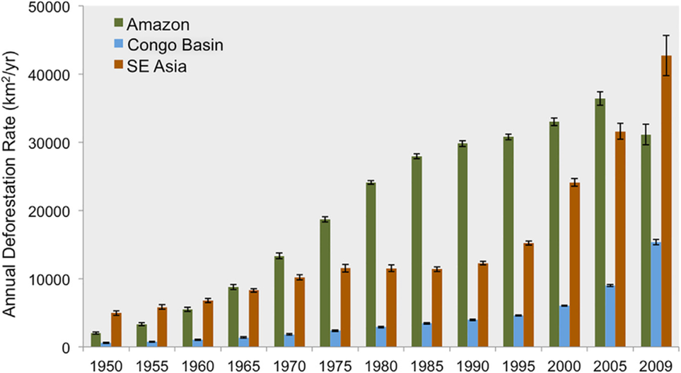
DEFORESTATION
https://www.researchgate.net/figure/Modeled-Annual-Deforestation-Rates-from-1950-to-2009-in-Five-Year-Intervals-Rates-are_fig1_305744650

Slide 27
ADAPTION
The goal is to reduce risks from the harmful effects of climate change.
It includes making the most of any potential beneficial opportunities associated with climate change (example: longer growing seasons or increased yields in some regions).
While climate change is a global issue, it is felt on a local scale.
Cities and local communities are focusing on solving their own climate change problems.
building flood defenses,
planning for heat waves and higher temperatures,
installing better-draining pavements to deal with floods and stormwater, and
improving water storage and use.

Slide 28
RESPONSE TO CLIMATE CHANGE DIS-BELIEVERS
“Climate change has happened in the past so it’s no big deal.”
That’s true but it occurred for reasons that don’t exist today.
“Climatologist don’t agree 100% on the cause of climate change.”
97% of climate scientist agree that humans are the major cause of climate change. Consider that 100% of politicians don’t have the same political views, and doctors don’t agree 100% on the best way of treating cancer; but we still have new laws and patients being cured of cancer.
“It would cost too much to mitigate climate change.”
Not doing anything will be more costly (i.e.: increased insurance costs, loss of insurance, higher food prices, loss of infrastructure, etc.)

Slide 29
WHAT YOU CAN DO
Consider your carbon footprint:
A carbon footprint is the total amount of greenhouse gases that are generated by our actions. The average carbon footprint for a person in the United States is 16 tons, one of the highest rates in the world. (https://www.nature.org)
Carbon footprint calculator: https://www.nature.org/en-us/get-involved/how-to-help/carbon-footprint-calculator/
Consider alternative sources of energy:
Solar cells
Wind generators
Electric/hybrid cars
Be careful who you vote for in all elections (local, state & federal).

Slide 30
RECOMMENDED WEBSITES
National Aeronautics and Space Administration (NASA):
https://climate.nasa.gov/
Environmental Protection Agency (EPA):
https://www.epa.gov/climate-change
United States Geological Survey (USGS):
www.usgs.gov/science/science-explorer/climate
Skeptical Science:
https://skepticalscience.com/

Slide 31
REFERENCES
Information and graphics: climate.nasa.gov
Title photograph: USGS.gov
Others as noted.

